Slide 1
First Look AT RENU2 PMT DATA
James Hecht
SSAL
The Aerospace Corporation

Slide 2
Aerospace Photometer Experiment
Overview:
Measure Zenith Brightness of 3 auroral features.
391.4 nm - N₂⁺ Resonance scattering
Significant emission above 350 km
N₂, O, and electron densities, electron and solar flux
630.0 nm - electron flux +O (lifetime ~110 s)
Significant emission above 350 km
Stronger background
557.7 nm – electron flux+O (above 250 km), N₂+O (lifetime ~ 1 s)
O, N2
O/N2 ratio
Need auxiliary Rocket and Radar Data
Description:
3 Filters bandpasses to isolate auroral features
Sunshades to eliminate unwanted solar photons
Angle Power Exiting (Watts)
50 1.9e-10
55 2.6e-12
65 1.9e-12
70 9.1e-13
Fiber Optic Cables transmit photons from Sunshades
3 PMTs to measure photons
PMTS in Aluminum Block
Block Cooled by LN2 on ground
Thermal Mass keeps PMTs cool during flight
Point of Contact: James Hecht

Slide 3
ANALYSIS
Strickland Models – emissions seen by uplooking PMTs
AURIC- calculates dayglow emissions
Altitude, location, time of day, model atmosphere
Scott Evans of CPI
B3C electron transport model - calculates auroral emissions
Altitude, location, time of day, model atmosphere, input electron spectra
Aerospace
Model Inputs can include EPLAS and/or Radar Data
Comparisons can be to Radar, Rocket PMT, or Ground-Based MSP/Imager
Emission Lifetime (tau) then N(t)=N(0)exp(-t/tau)
Examples for tau of 100 s (1 Rayleigh is 10^6 ph/cm2-s)
Excitation lasts 1 s
During first second only 1% emit
So brightness in Rayleighs is reduced by 100
In 100 s about (e-1)/e emit
Excitation lasts 100 s or longer
During first second only 1% emit
After about 100 s steady state is achieved
Brightness in Rayleighs not reduced

Slide 4
EPLAS DATA
As Supplied by Bruce Fritz in May 2016
Data are in ergs/cm2-s-sr
I multiplied by Pi to convert to ergs/cm2-s (Strickland model Analysis)
Divided by 18 for these results
Re-analysis will be needed when updated EPLAS results available
Probably could use actual pitch angle distribution

Slide 5
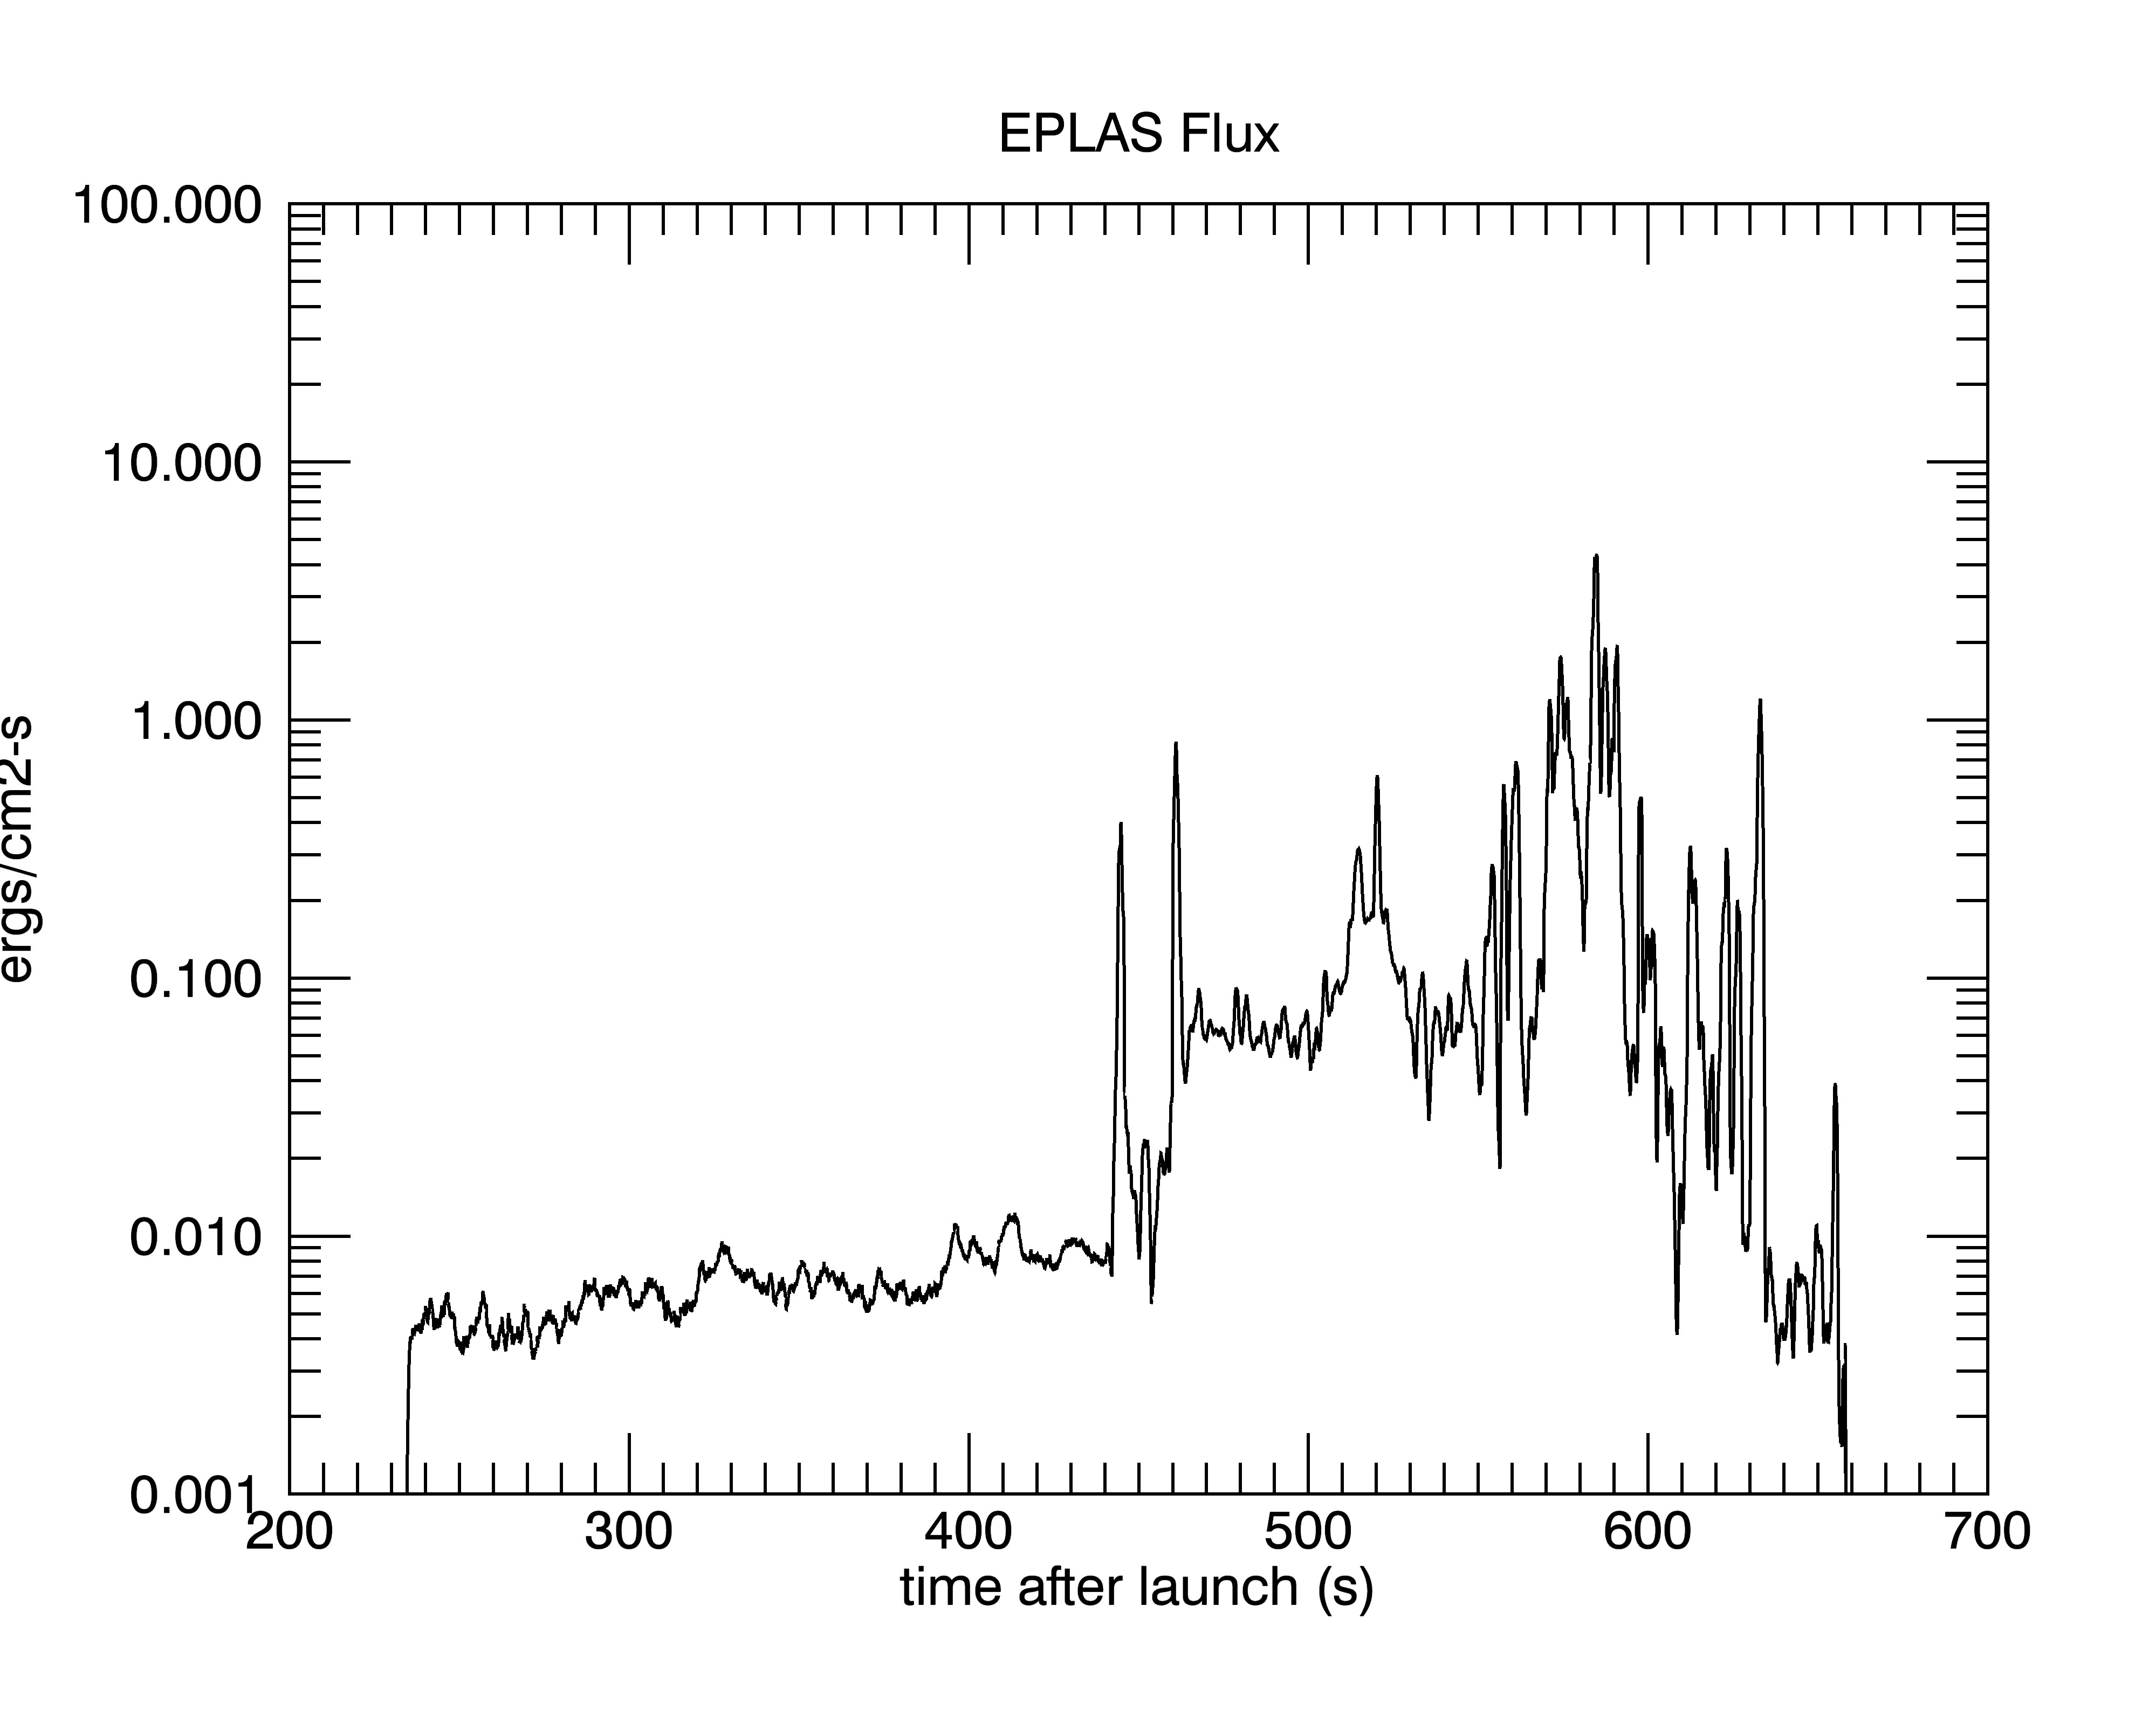

Slide 6
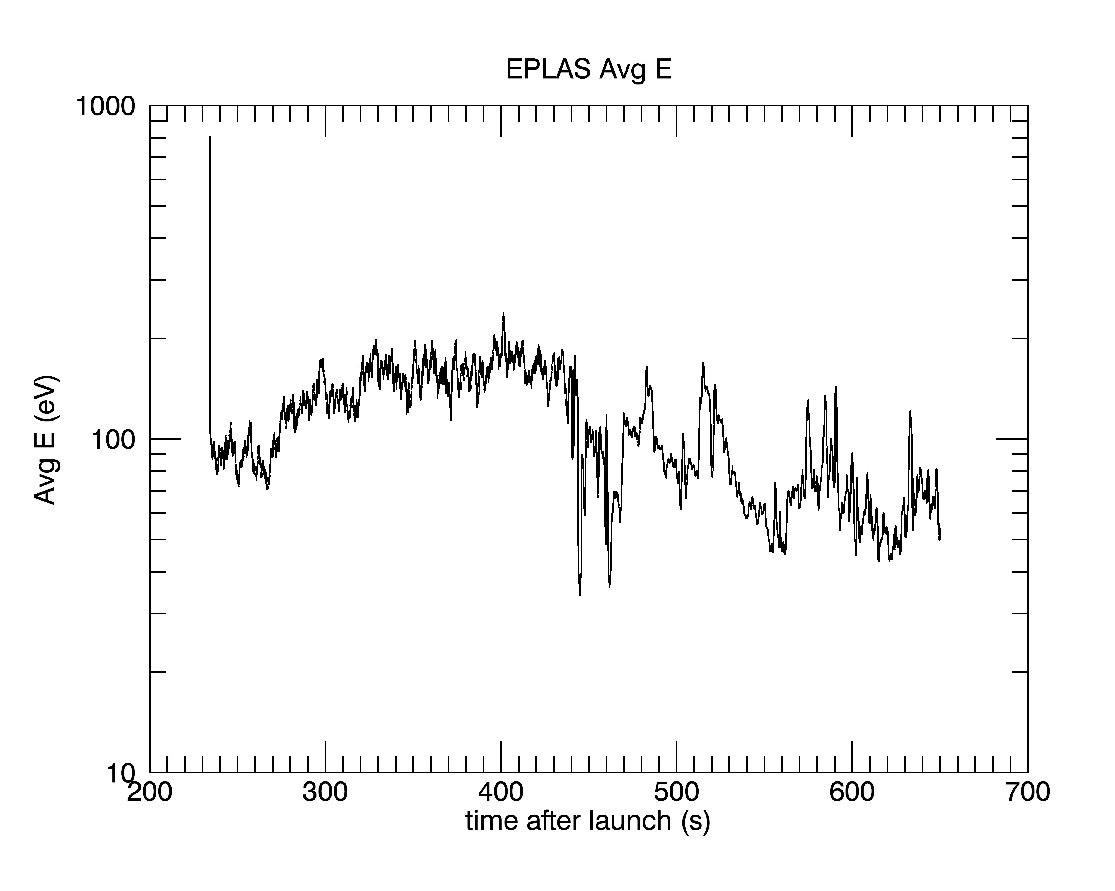

Slide 7
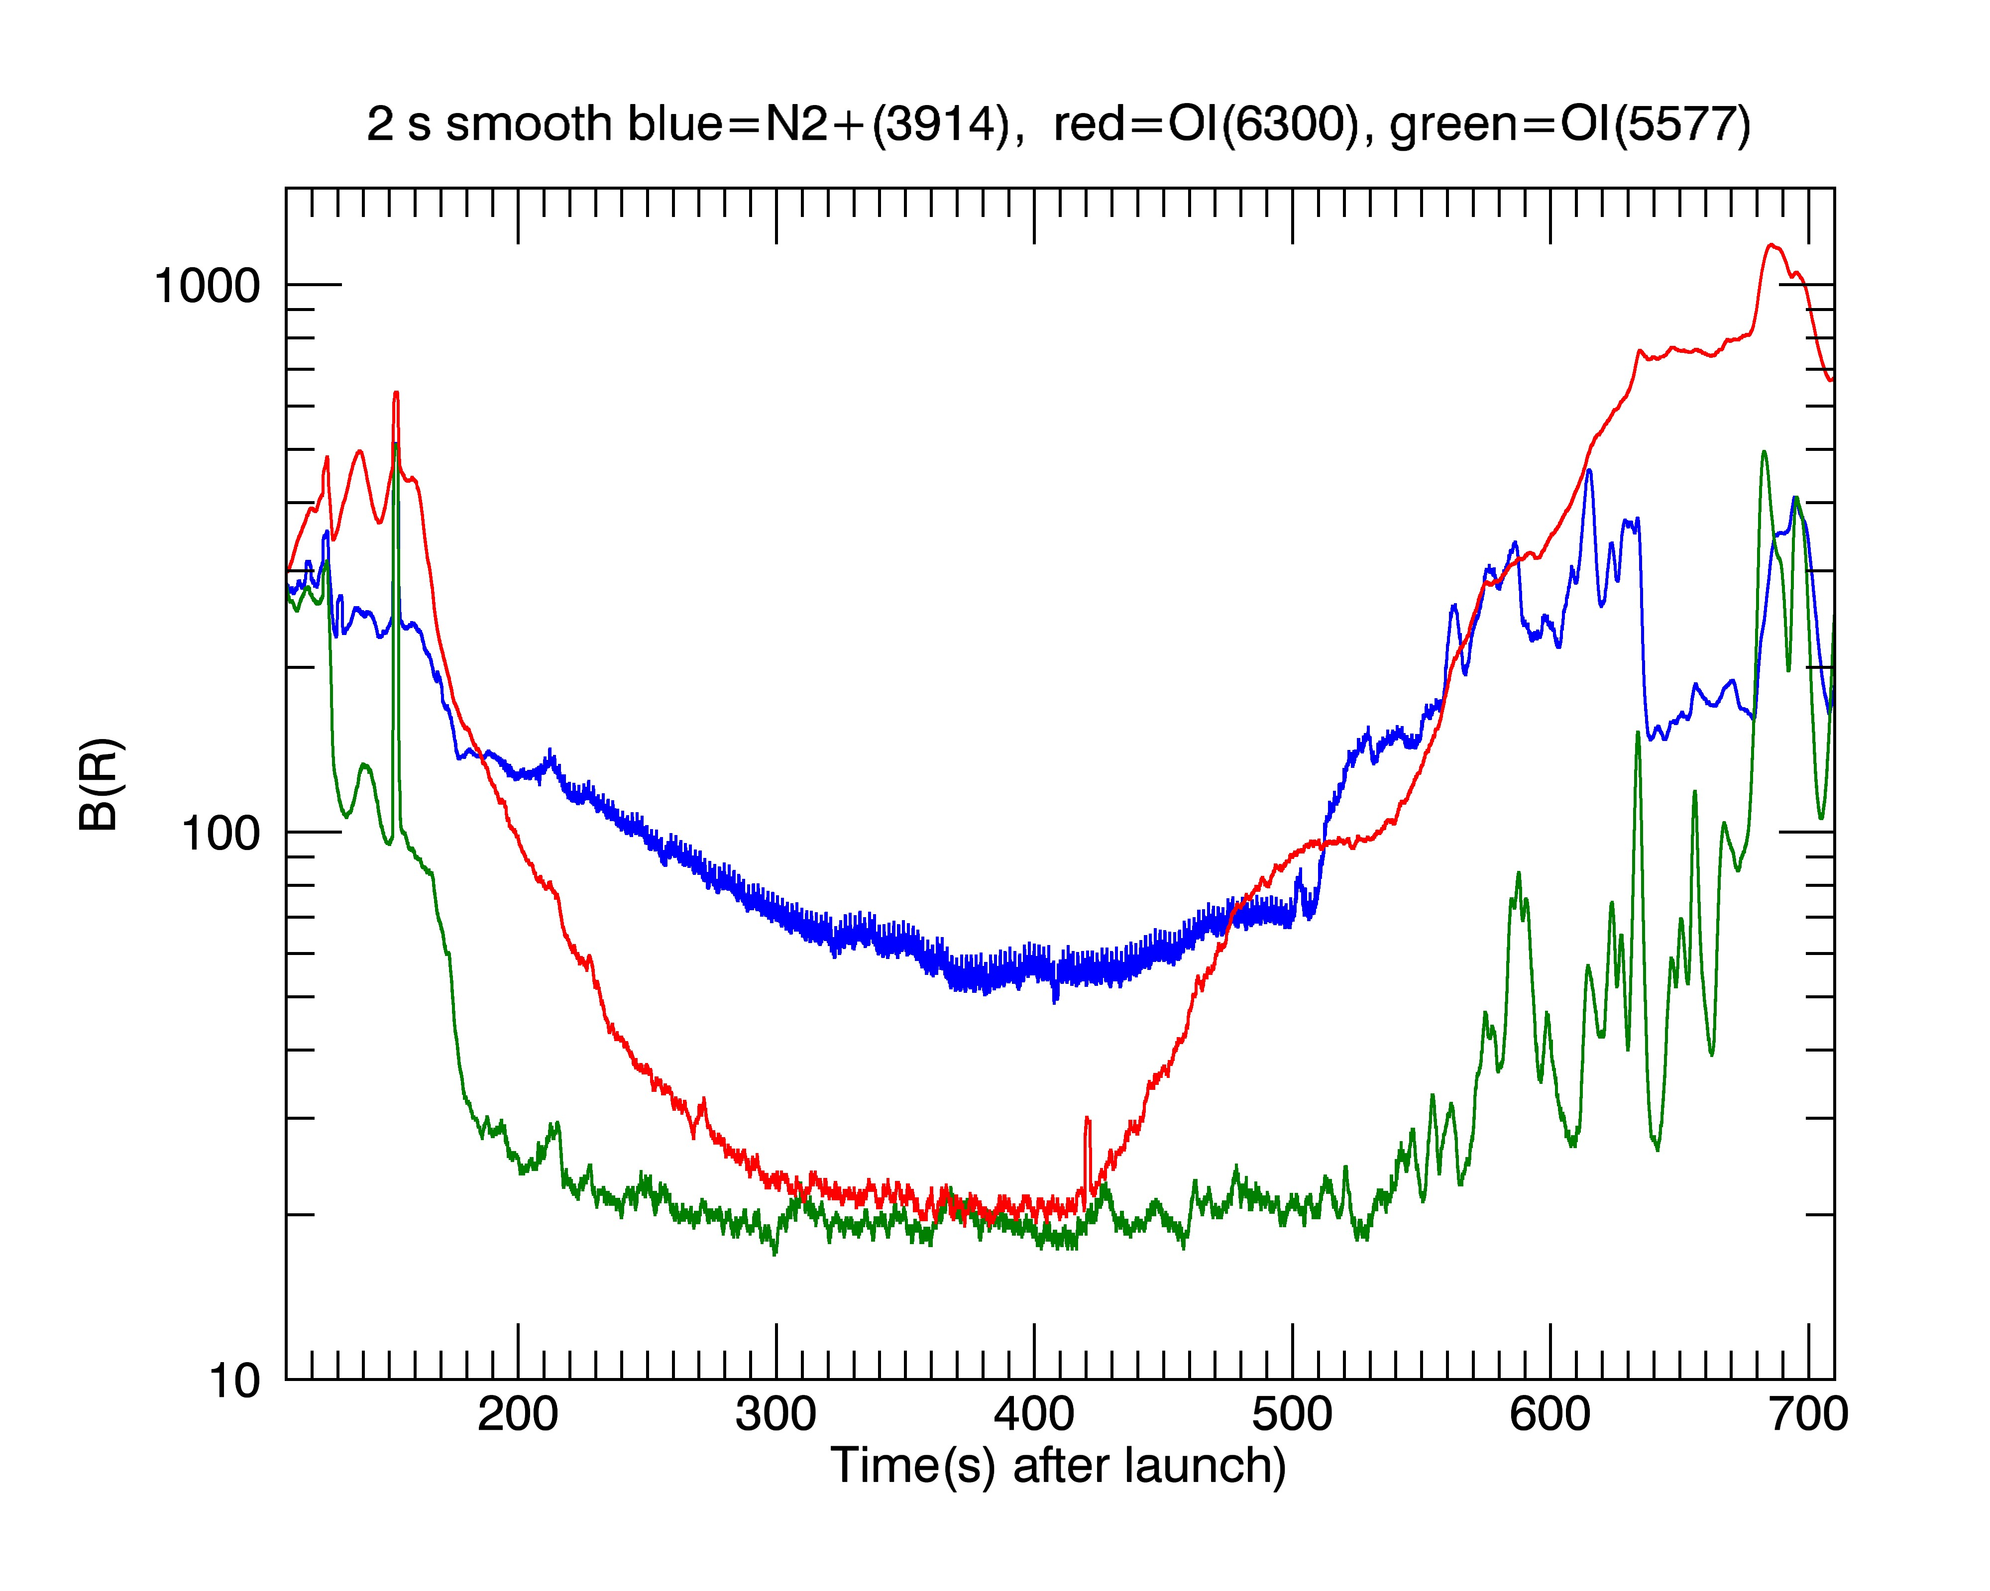

Slide 8
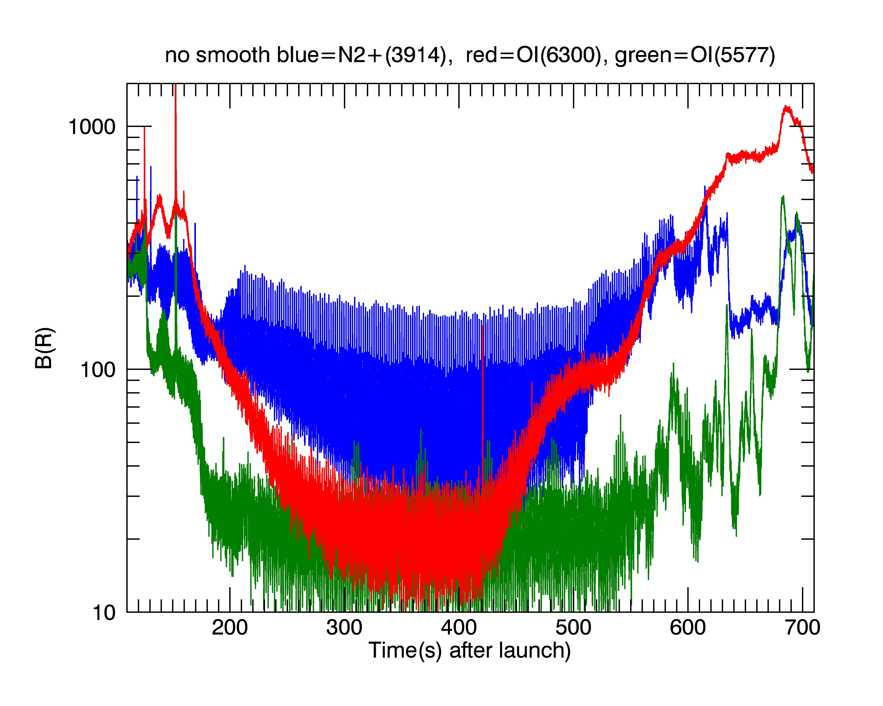

Slide 9
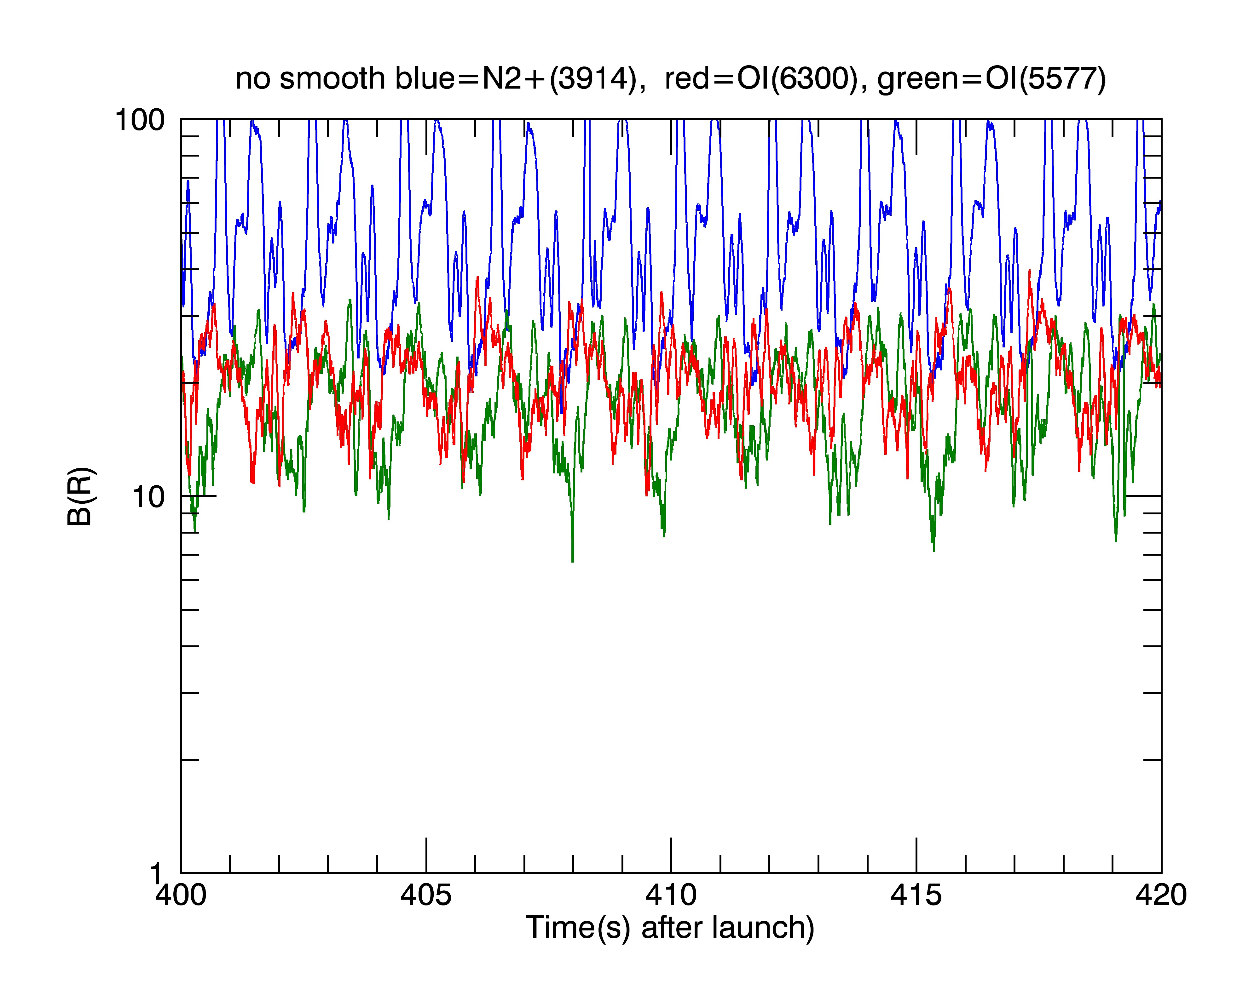

Slide 10
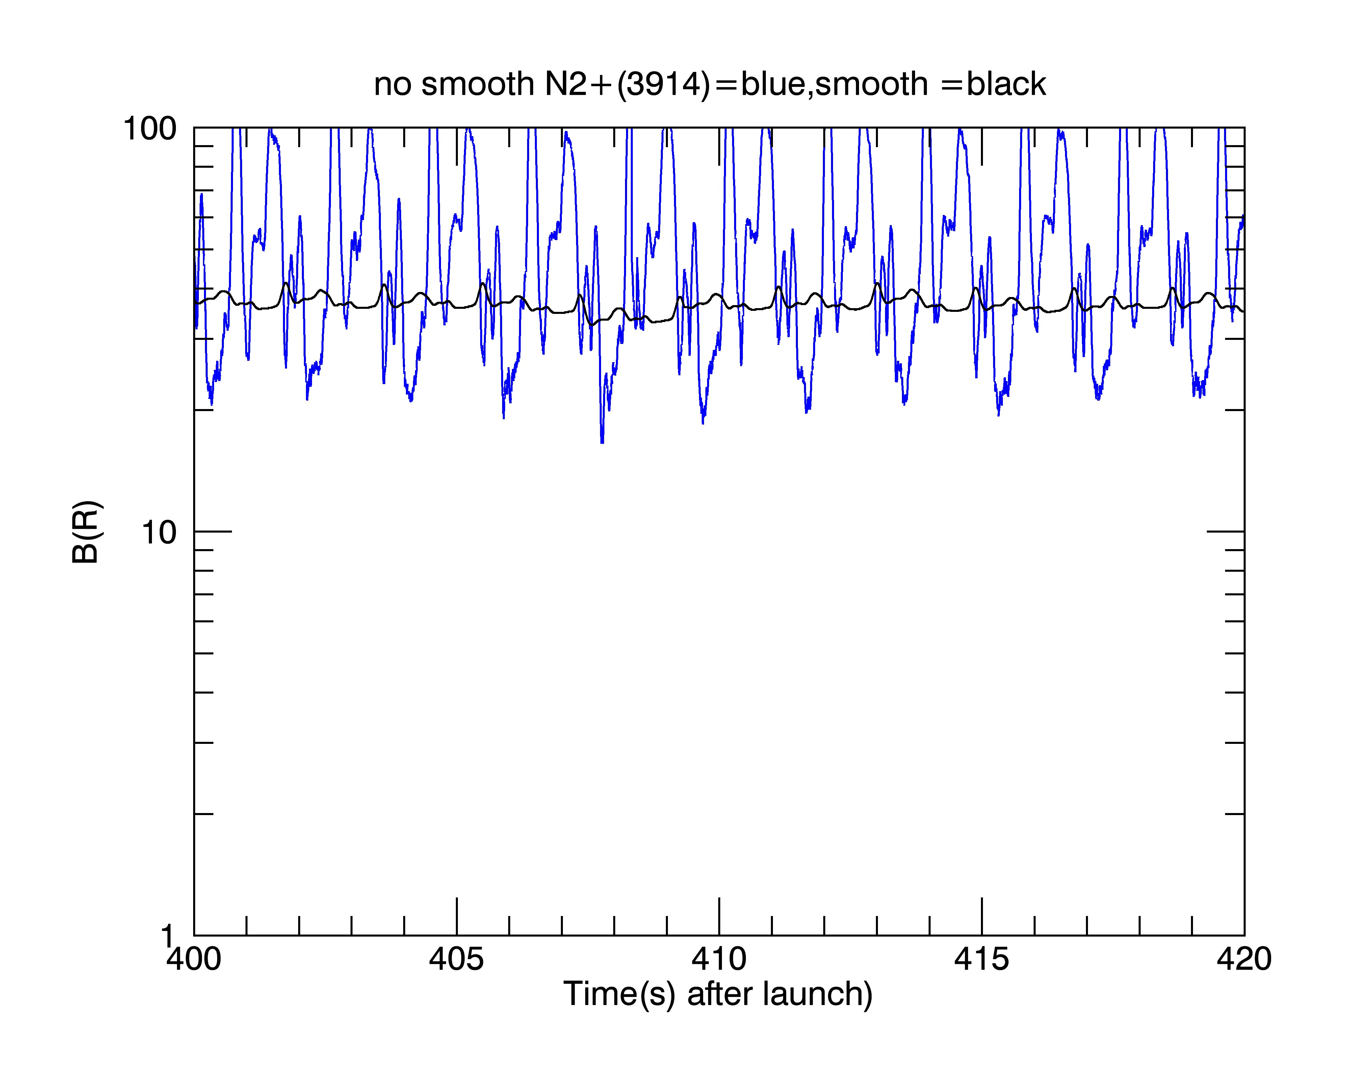

Slide 11
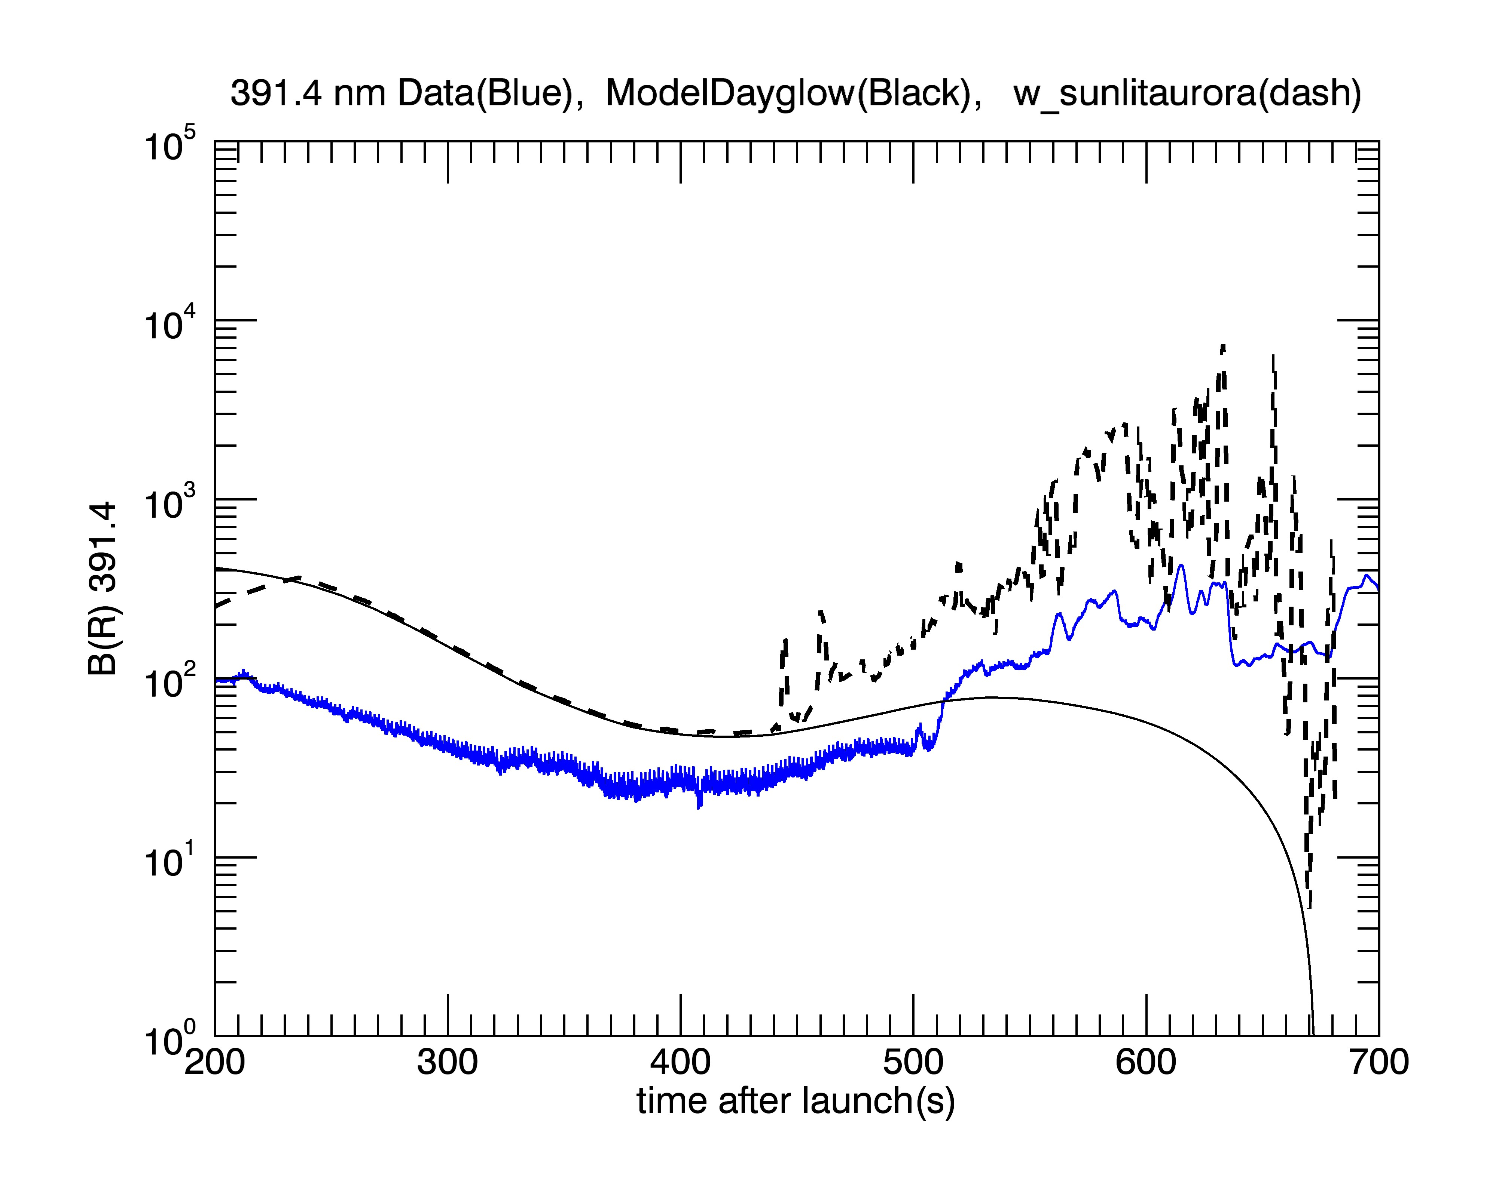

Slide 12
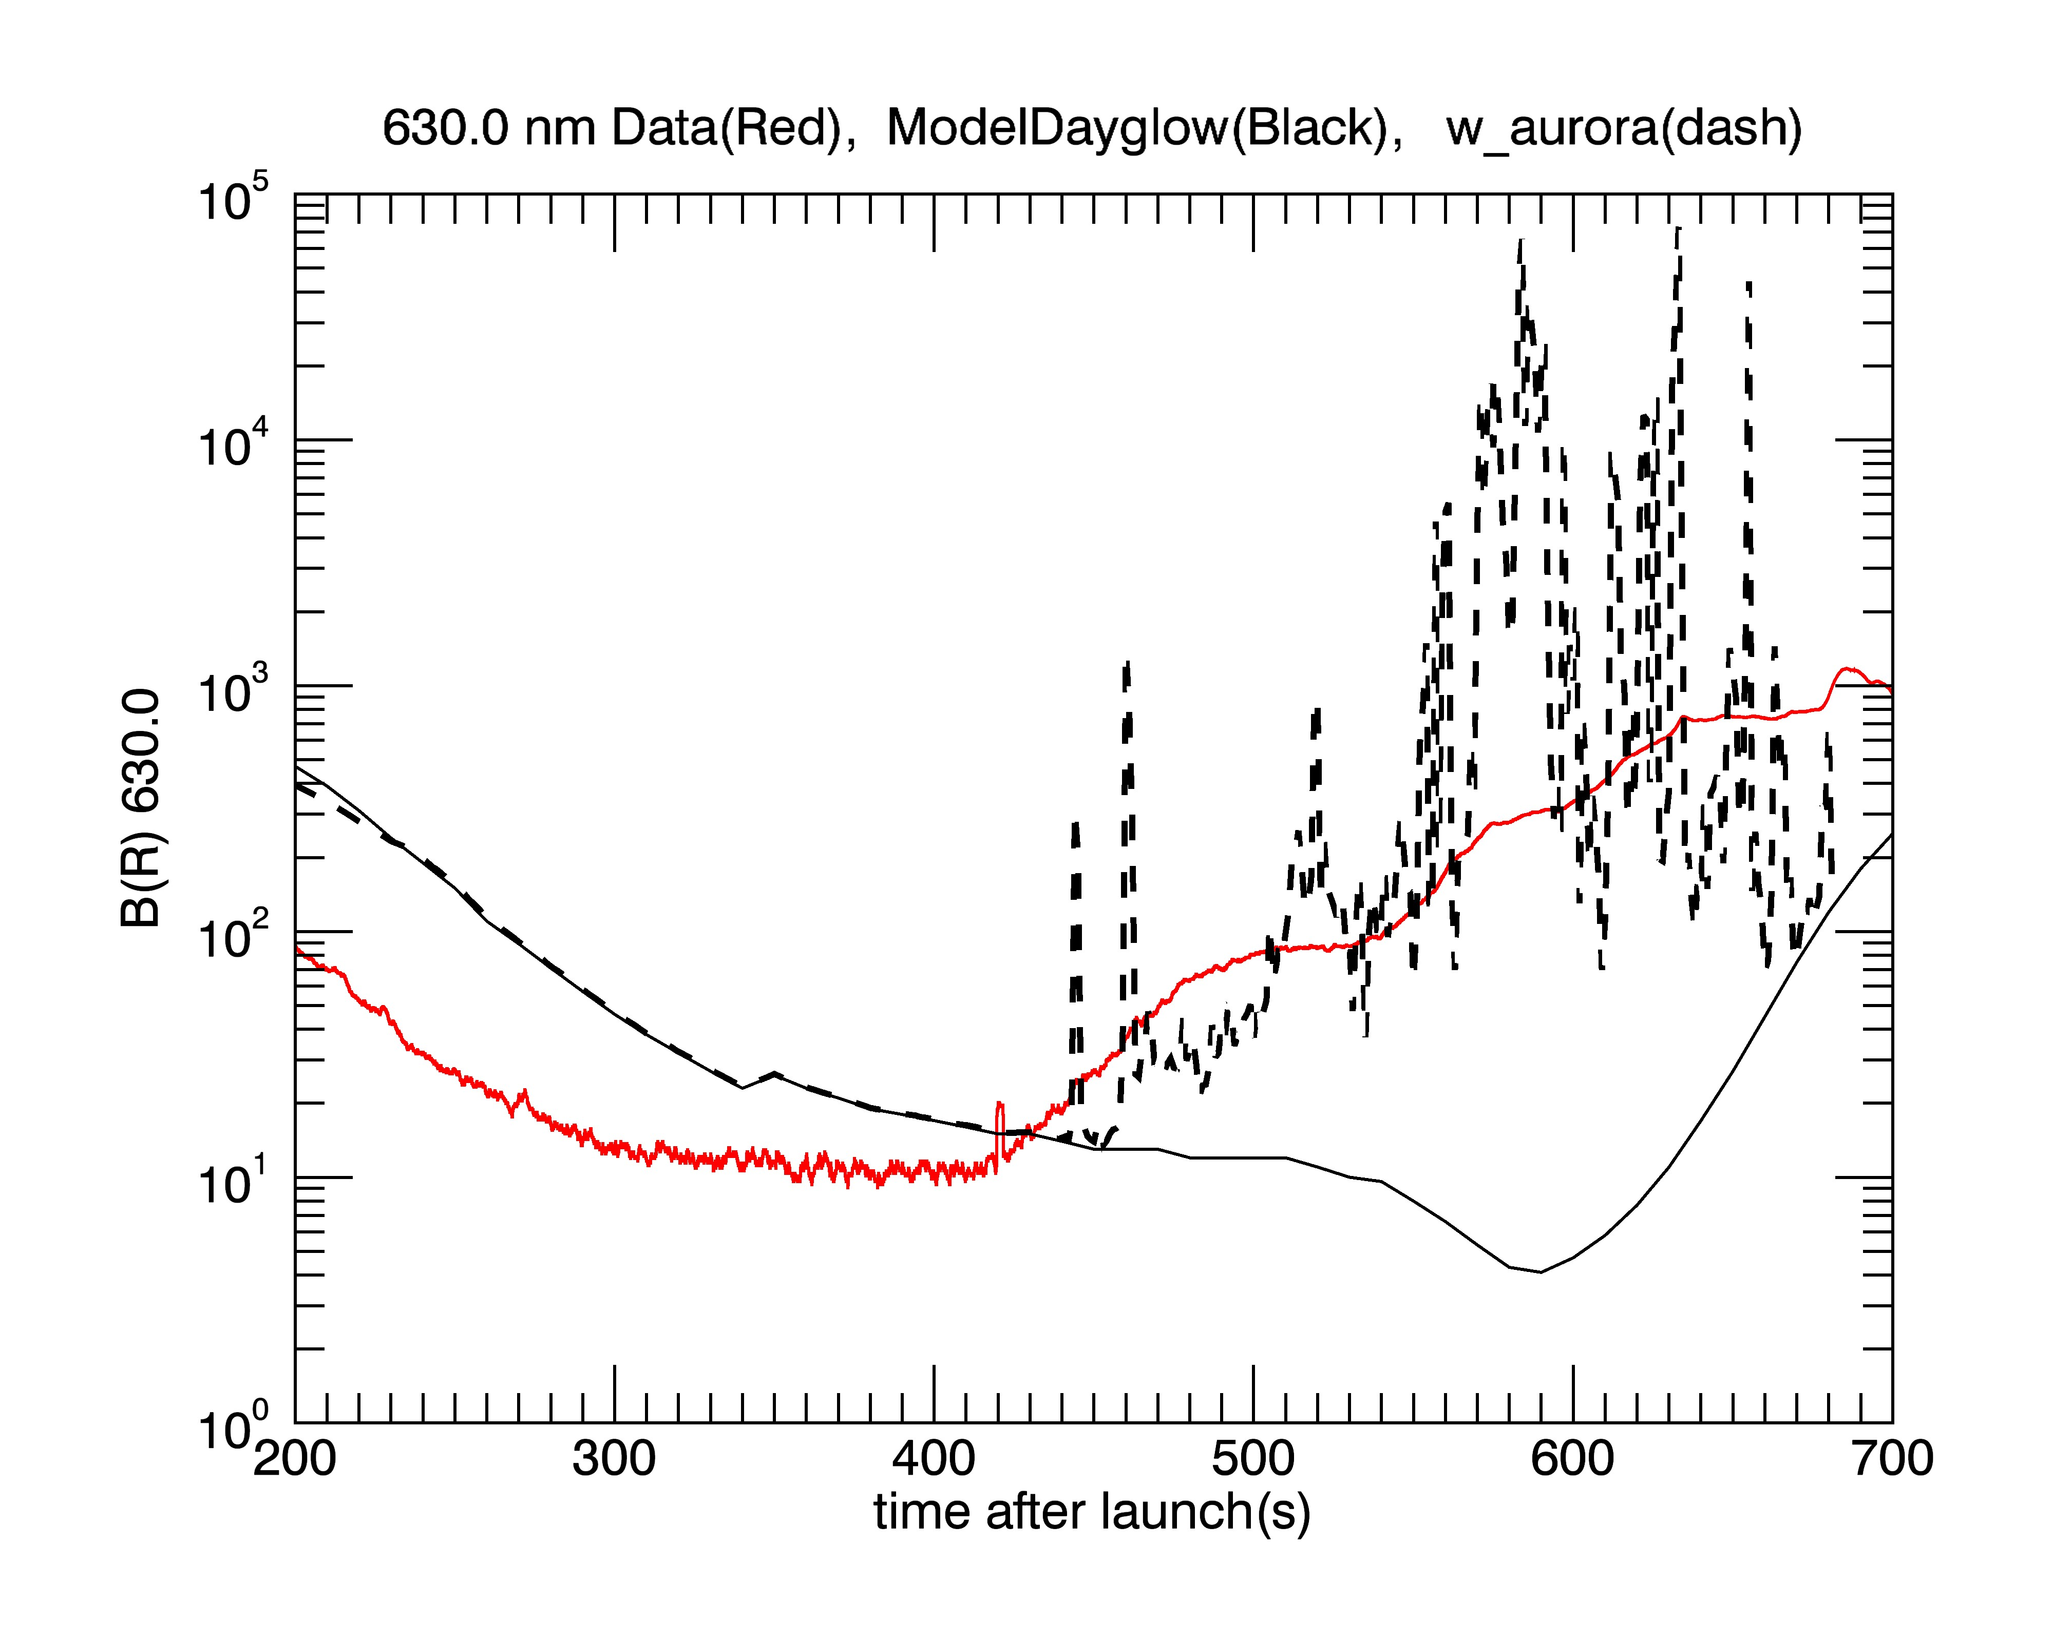

Slide 13
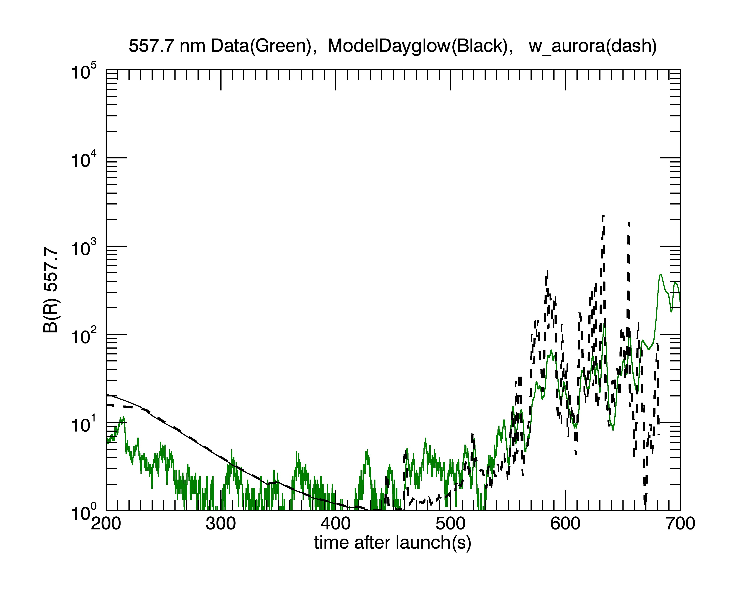

Slide 14
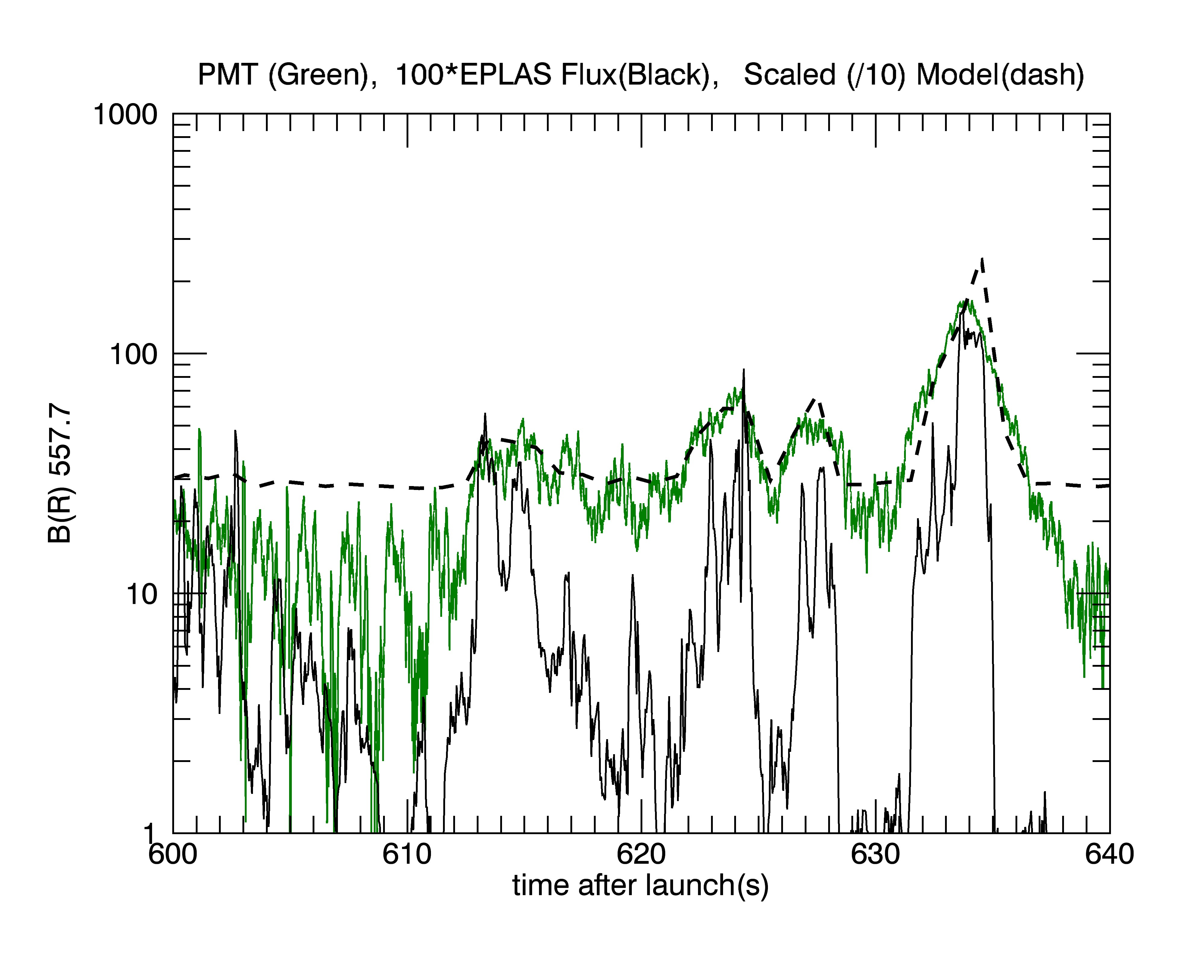

Slide 15
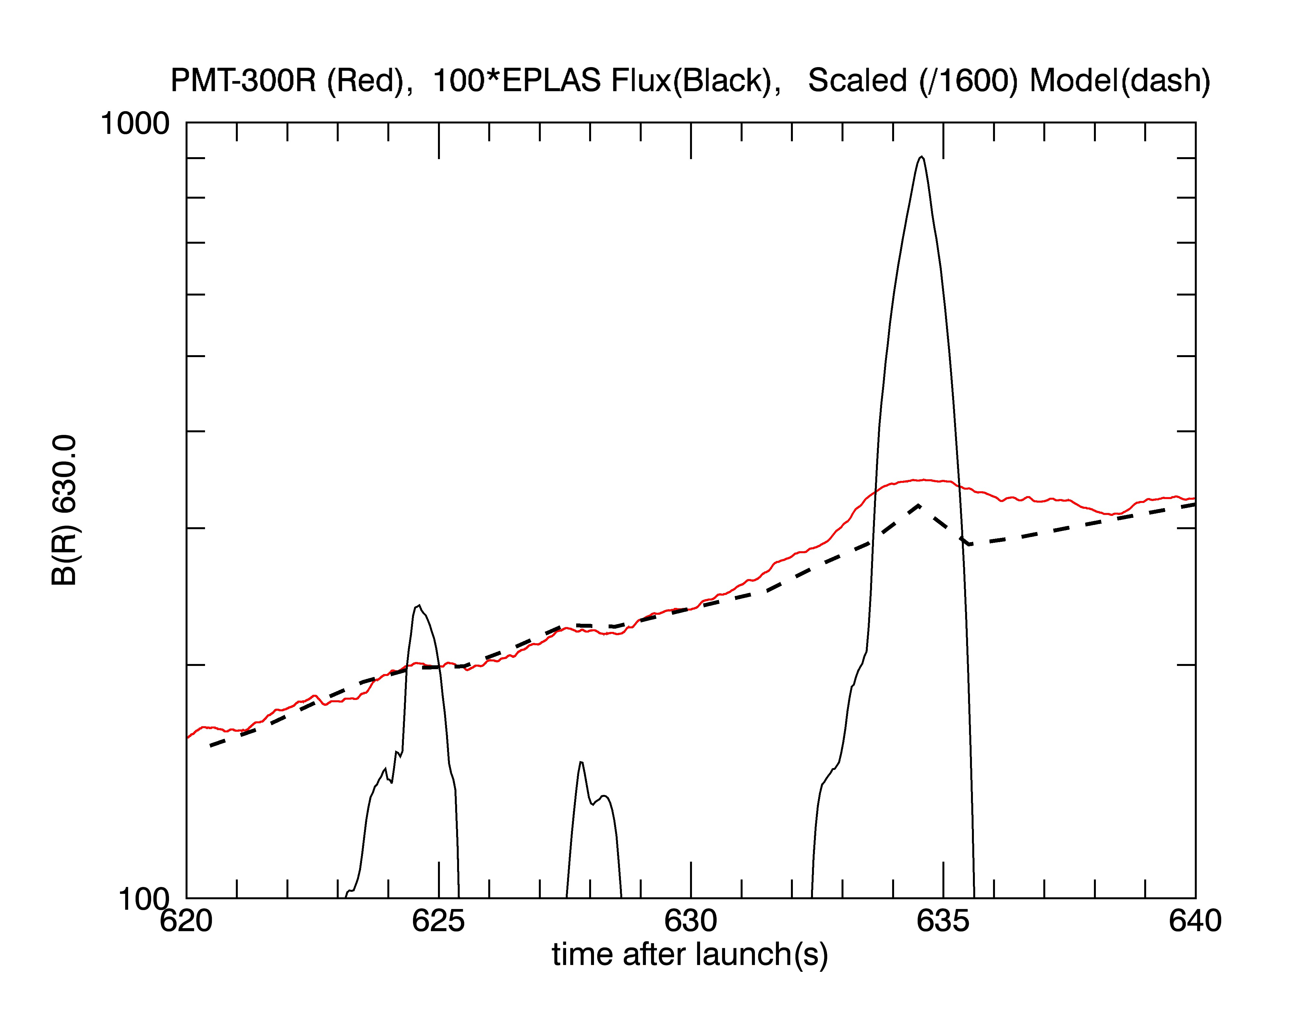

Slide 16
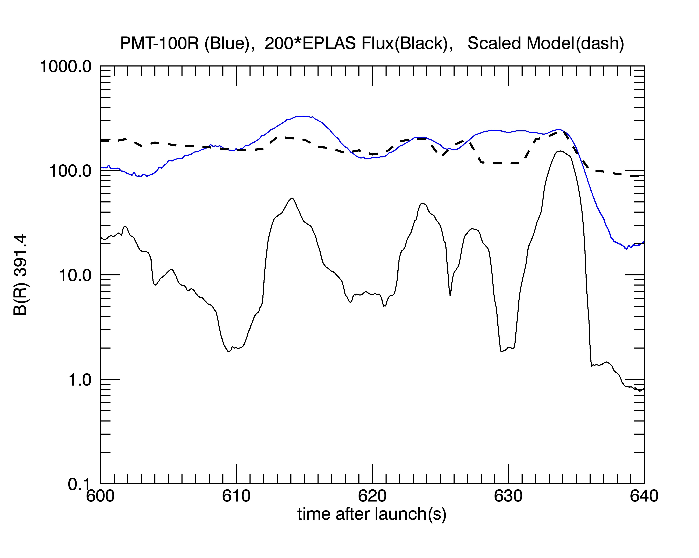

Slide 17
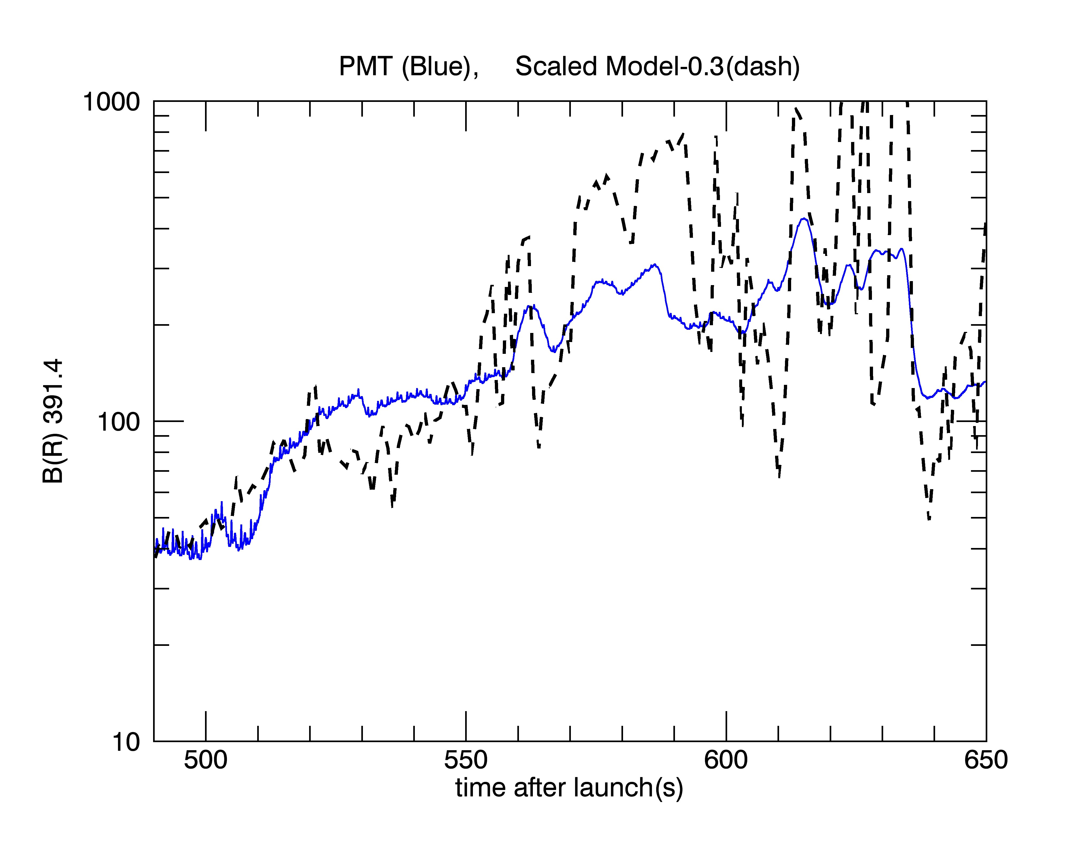

Slide 18
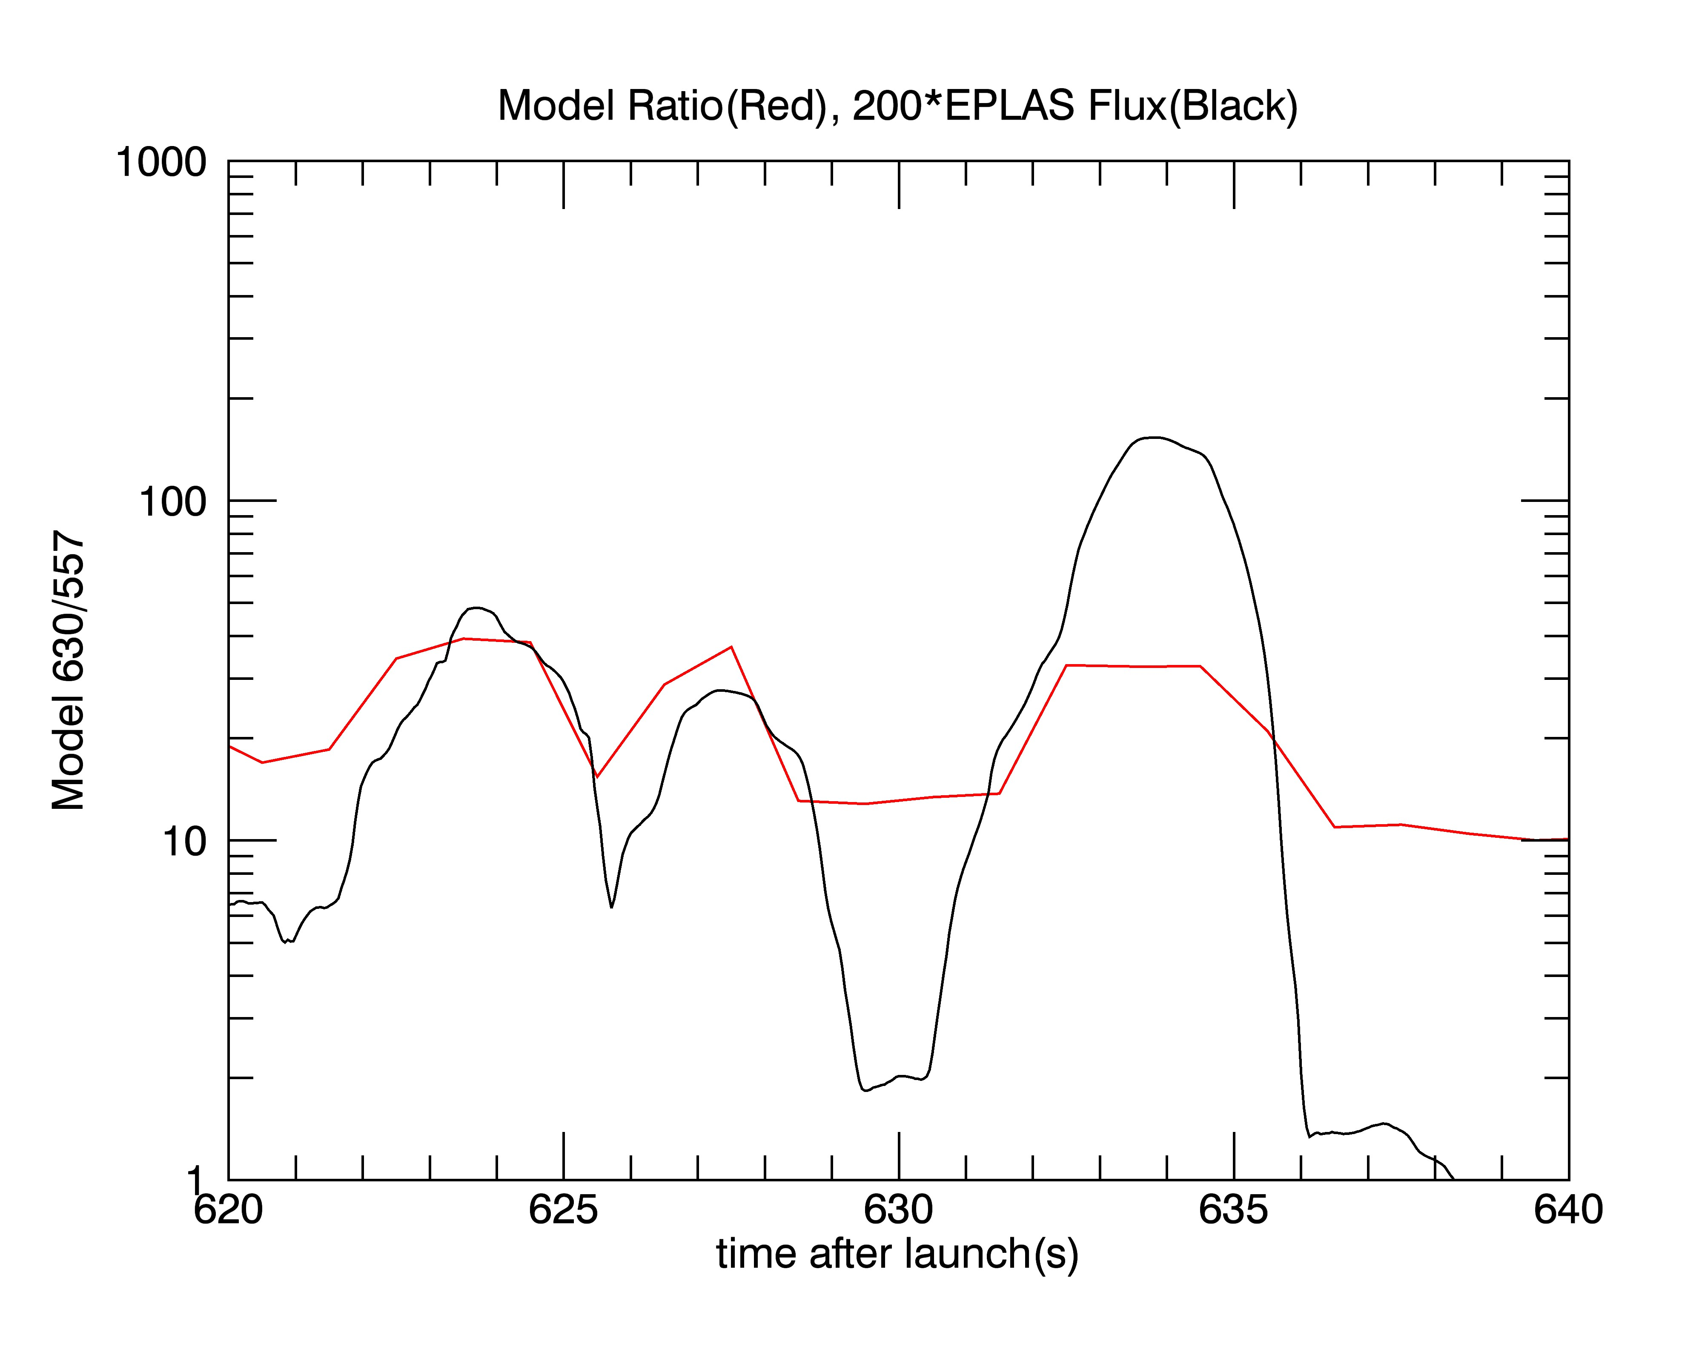
6300/5577
If 1 sec fluctuation then 6300 is reduced by about a factor of 110 compared to 5577
But 6300/5577 model is about 30
So 5577/6300 should be about 4
Measured 5577/6300 is about 4 to 5
Implies short time scale
In addition 6300 is reduced by a factor of about 1000 implies about 0.1 to 0.2 s
5577 is reduced by about a factor of 10 implies about 0.1 s fluctuation

